Slide 1

Risk Analysis and Threat Modeling
Assistant Prof. Dr. Devrim ÜNAL
KINDI Center for Computing Research
TUBITAK BILGEM

Slide 2
DEFINING SECURITY RequIREMENTS

Slide 3
Importance of Security Requirements
It is necessary to address security risks
Is an important part of risk resolution
Is a task compulsory in many standards
ISO 27001 control item 14.1.1 (Information security requirements analysis and specification)
SRS (Security Requirements Statement) in project lifecycle of international organizations.

Slide 4
Best practices in defining security requirements
ISO 27002 advices the following practices :
Policy, roles and responsibilities for security requirements analysis
Defining methods for requirements elicitiation
Requirements review by stakeholders
Requirements prioritization based on risk assessment
Requirements management practices
Defining product acceptance criteria

Slide 5
Security Requirements Process
Assets Analysis
Asset Inventory
Asset Valuation
Threat Analysis
Threat Agents
Threat Classification
Security Requirements
Functional Requirements
Non-Functional Requirements
SRS (Security Requirements Statement)/SSRS (Systems Specific Security Requirements Statement)
ISRA-Initial Security Risk Assessment
Risk
Analizi

Slide 6
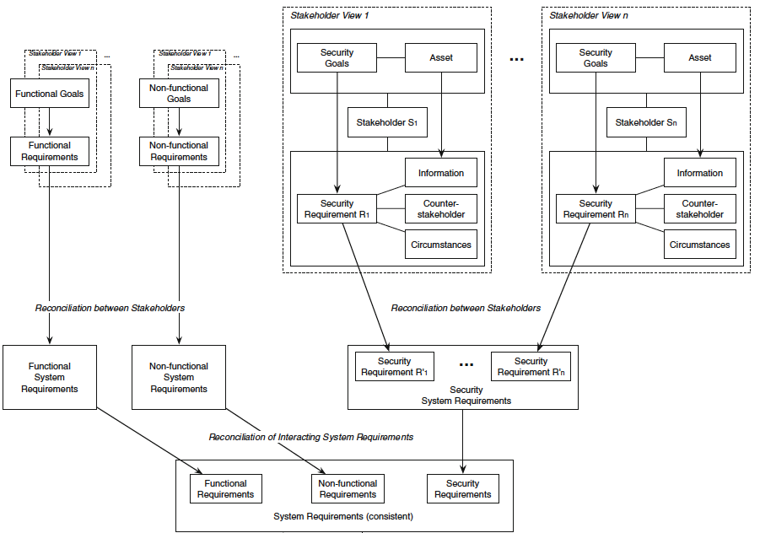
Security Requirements Elicitation

Slide 7
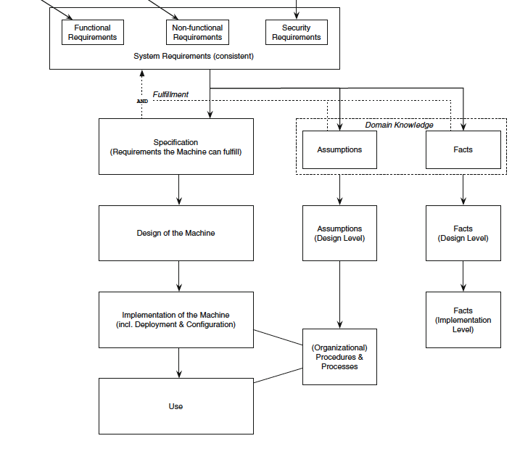
Security Requirements Elicitation

Slide 8
Establishing Traceability of Security Requirements
Establish traceability of system requirements to security requirements
Establish traceability of system and security requirements to design requirements
Establish traceability of system, security and design requirements to test cases
Establish traceability of all requirements to project plan work items

Slide 9
Risk analysIS

Slide 10

Risk based methodology: Know and treat your risks, before the adversary exploits them.

Slide 11
Definition of Risk according to ISO
Risk: effect of uncertainty on objectives [ISO Guide 73:2009]
An effect is a deviation from the expected — positive and/or negative.
Objectives can have different aspects (such as financial, health and safety, information security, and environmental goals) and can apply at different levels (such as strategic, organization-wide, project, product and process).
Risk is often characterized by reference to potential events (3.3) and consequences (3.1), or a combination of these.
Information security risk is often expressed in terms of a combination of the consequences of an information security event and the associated likelihood (3.9) of occurrence.
Uncertainty is the state, even partial, of deficiency of information related to, understanding or knowledge of, an event, its consequence, or likelihood.
Information security risk is associated with the potential that threats will exploit vulnerabilities of an information asset or group of information assets and thereby cause harm to an organization.

Slide 12
What is risk management?
Risk management: All activities in an organization related to managing and directing the organization from the point of view of risks
[ISO 31000:2009]

Slide 13
Scope of risk management
When, what, the effect?
Systematic assessment of risk based on available information
Compare risk level to certain criteria and prioritize
Determine and implement options to reduce effect of risk or prevent it completely

Slide 14
Risk Analysis
Analysis of security protection requirements
Asset analysis
Impact analysis
Threat analysis
Vulnerability analysis
These inputs are fed into the risk assessment step.

Slide 15
Risk Analysis Concepts
Asset
Vulnerability
Mitigated risk
Threat
Risk
Risk Mitigation

Slide 16
Risk Evaluation Methodologies
CORAS
CRAMM
EBIOS
FAIR
FRAP
IRAM
ISAMM
ISO/IEC 27005
IT GRUNDSCHUTZ
MAGERIT
MEHARI
NIST SP 800-30
OCTAVE
SRA
TARA

Slide 17
Risk Formula
A simple and widely adopted formula for risk:
Risk = Probability * Impact
Where (calculation of these variables depend on the standard or process followed),
Probability = Easiness of attack * Value of asset to the attacker
Impact = MAX (Value of asset to the organization, Indirect effects of the attack)

Slide 18
Asset Inventory
Some assets in a software environment
Information assets
Business rules
Services and functions
Source code
Intellectual property
Encryption keys
Databases
People and their competencies
Account information and funds associated with accounts
Transaction logs

Slide 19
Asset Identification: DFD Method
Element | Symbol | Definition
Process |  | Any running code
External Entity |  | Entities which interact with the application and are external to the application
Data Store |  | Every location for data, such as a file, registry, database, cloud filestore, etc.
Data Flow |  | Data flow is a transfer of data from one element to another.
Trust Boundary |  | Is the boundary separating high privilege areas from low privilege areas.

Slide 20
DFD Context Diagram
External Cloud Service Provider
Client
Addresses of external
CSP
User
Cloud Storage Service
Service configurations
Server
Web Server
Remote Connection of System Admin

Slide 21
DFD Level-0 Diagram
JS
Code
Web
Browser
HTML
Code
User
Ajax
Code
Read, Write, Update
Cookie

Slide 22
DFD Level-1 Diagram
I&A Service
Server Code
GUI
HTML Code
Storage Service
Cloud Storage Service
Ajax Code
Cloud Storage Service Configuration

Slide 23
Asset Valuation
Material Value Impact on business | Low | Medium | High
Low | Information assets (General) | Transaction records | Account information
Medium | Business Rules | Source code | Persons Customer DB
High | User database | Software services Encryption keys | Intellectual Property
Also
Delphi method, Linear Evaluation (ISO 27005) B.2

Slide 24
Impact Assessment
A threat can affect one or more assets
A threat can affect an asset partially
The impact value is calculated with a function that takes into account all assets that can be affected by the threat:
Most valuable among all assets (MAX)
The sum value of all assets (SUM)

Slide 25
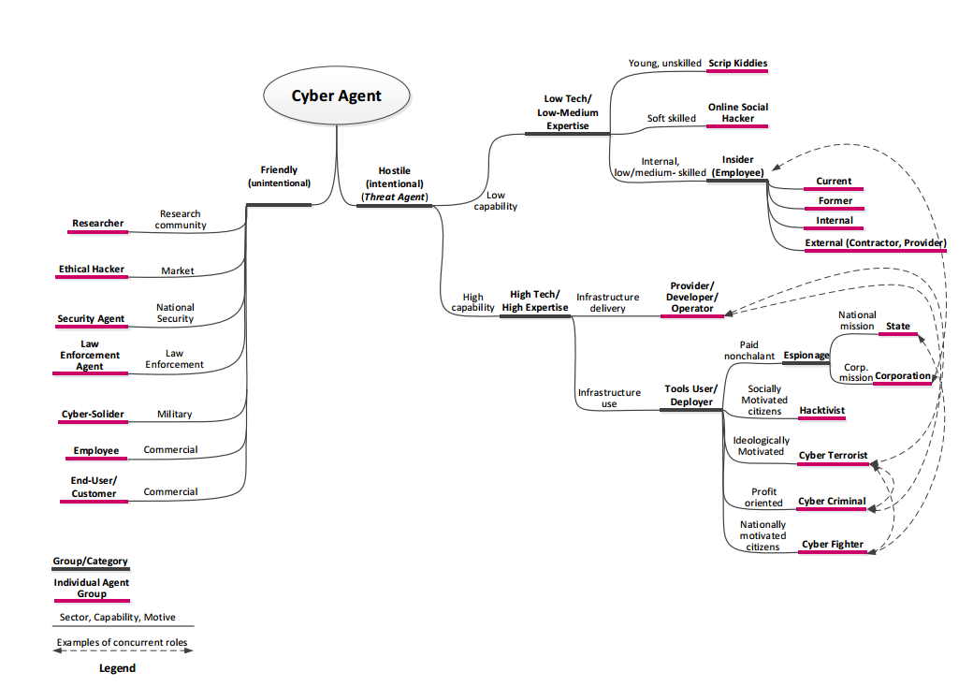
Threat Categorization
ENISA Threat Landscape 2015 - Europa
https://www.enisa.europa.eu/publications/etl2015/at_download/fullReport

Slide 26
Threat Profile Assessment
Resources -------------------------- Technical complexity | Low | Medium | High
Low | Script Kiddie | Cyber Fighter | Cyber Terrorist
Medium | Online Social Hacker | Cyber Criminal | Malicious Provider/Developer/Operator
High | Insider | Hacktivist | Espionage
Also: ISO 27001 Annex C

Slide 27
Evaluating threat profiles
Categories are determined for the evaluation of threat profiles, e.g.
Cat. A (Orange) -> Threat degree = Low
Cat. B (Blue) -> Threat degree = Medium
Cat. C (Green) -> Threat degree = High
Calculation of probability of attack
Easiness of attack*Value of asset to the attacker
Example: Easiness of attack: Low=0.8, Medium=0.4, High = 0.2 Value of asset to the attacker: Low=0.2, Medium=0.4, High = 0.8 Then the probability of attack for (Low, Low) = 0.8*0.2 = %16

Slide 28
Some Examples to Threats
Electromagnetic emanations
System errors
Data structure errors
Eavesdropping
Lack of logging
Insecure installations
Infiltration into IT systems
Malware
Man-in-the-middle
Exploiting software vulnarabilities
Denial-of-Service – DoS, DDoS
Session hijacking

Slide 29
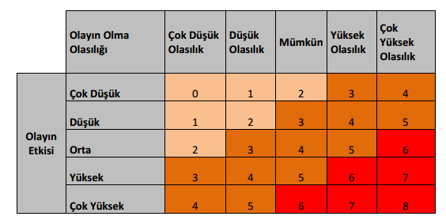
Preliminary risk analysis
Using qualitative methods provide answers quickly.
Probability
Very Low Possible Likely Very
low likely
Impact
Very low
Low
Medium
High
Very High

Slide 30
Example
Examples for scaling:
Low risk:0-2
Medium risk: 3-5
High risk: 6-8
Probability scales:
Never happened before : Very low
Happens once in a few years : Low
Happens every year : Possible
Happens more than once every year : Likely
Happens once in a few months: Very likely
Impact:
Can be resolved in shorter than a day (Very low)
Can be resolved in longer than a day (Low)
Can be resolved in more than a week (Medium)
Partially permanent damage (High)
Permanent damage (Very high)

Slide 31
Quantitative Analysis
Risk = Probability*Impact
Probability = (Vulnerability * Threat level)
Impact = MAX (Value of asset, Indirect cost of attack)
Example: Asset: Credit card information
Threat profile: Cyber Criminal
Threat level = 0.4
Vulnerability = 0.5 over 1.00
Probability = 0.40*0.5 = 0.20
Value of asset to the organization = 0.10
Indirect cost of attack = 0.4
Impact = MAX (0.1,0.4)=0.4
Risk = 0.20 * 0.4 = 0.08 over 1.00 (%8)

